Slide 1
04 | Advanced Functions
Jeffrey Snover | Distinguished Engineer & Lead Architect
Jason Helmick | Senior Technologist, Concentrated Technology

Slide 2
Module Overview
The purpose to Advanced Functions
An Advanced Function template
Creating and testing parameters
Adding your code
Writing objects out to the pipeline

Slide 3
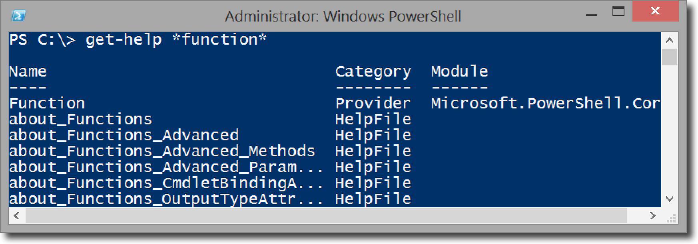
The purpose to Advanced Functions
You can create functions that are similar to cmdlets using PowerShell
These are not the same as compiled cmdlets, but are perfect the for IT pro!

Slide 4
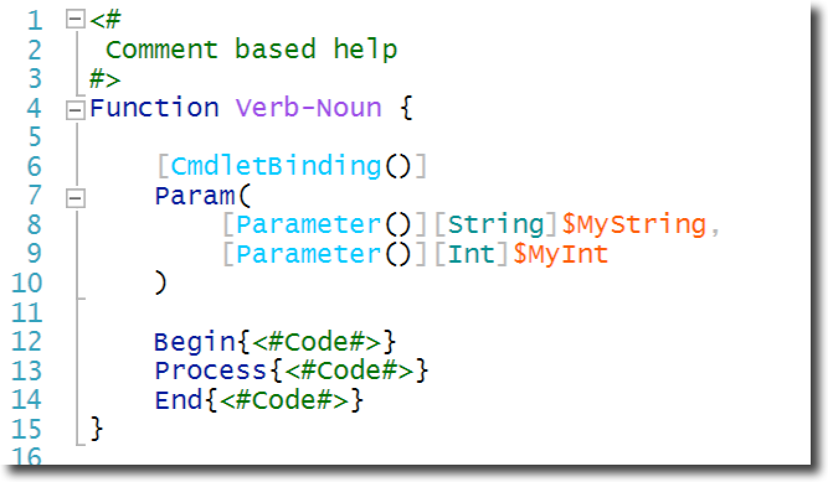
Advanced Function template
You can make your own
The ISE has built-in templates
Try Ctrl-J

Slide 5
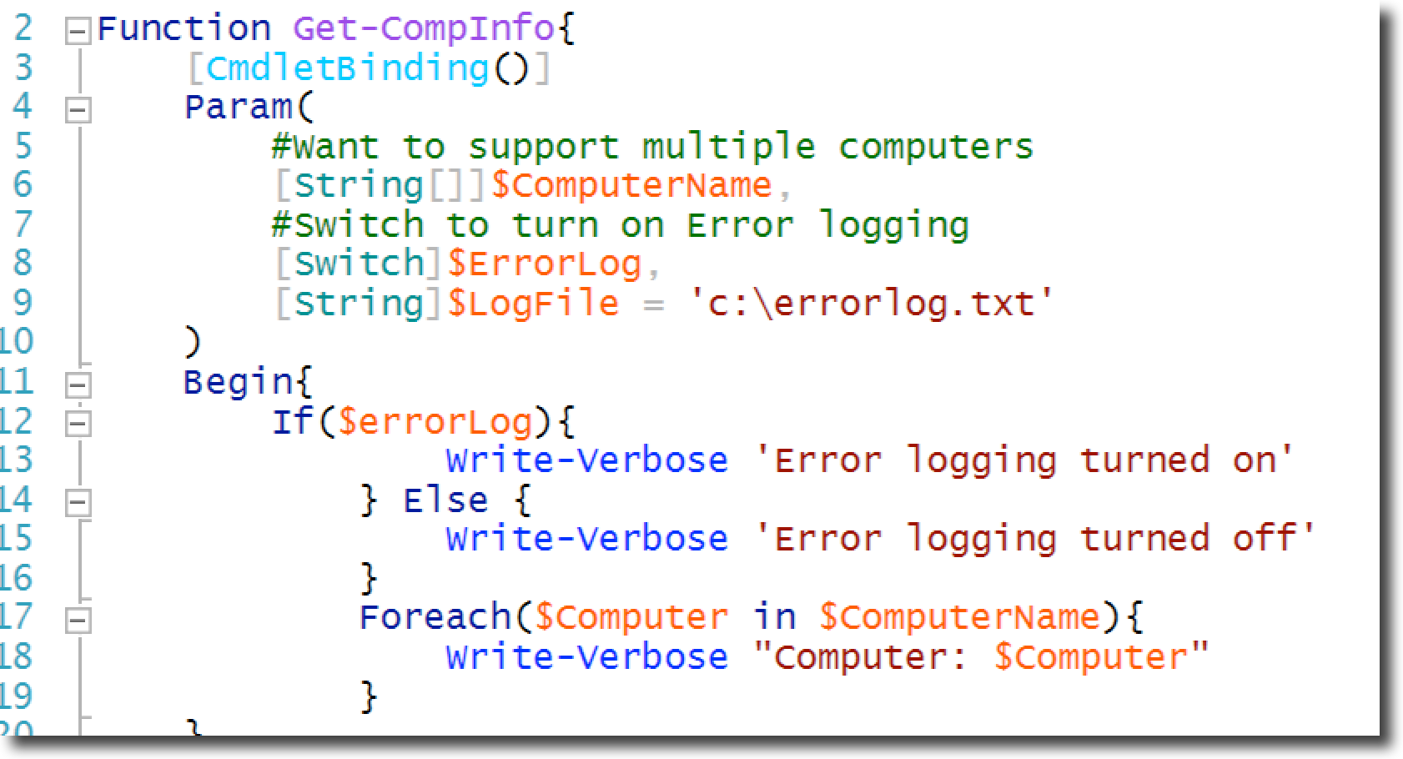
Creating and testing parameters
Can test params using IF and Foreach constructs

Slide 6
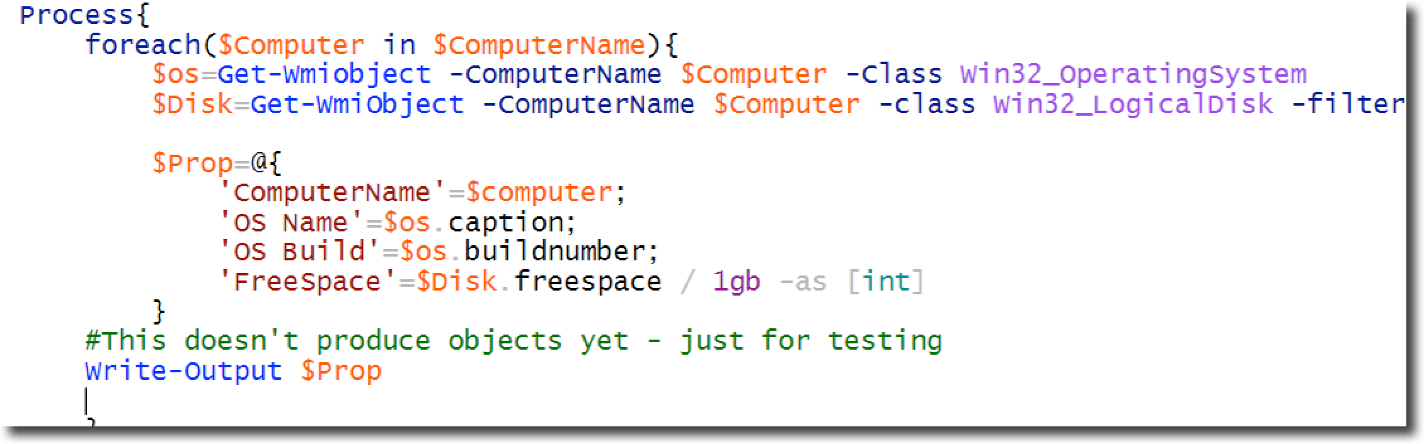
Adding your code
The Foreach iterates through the computer names
Place the properties into a hash table

Slide 7
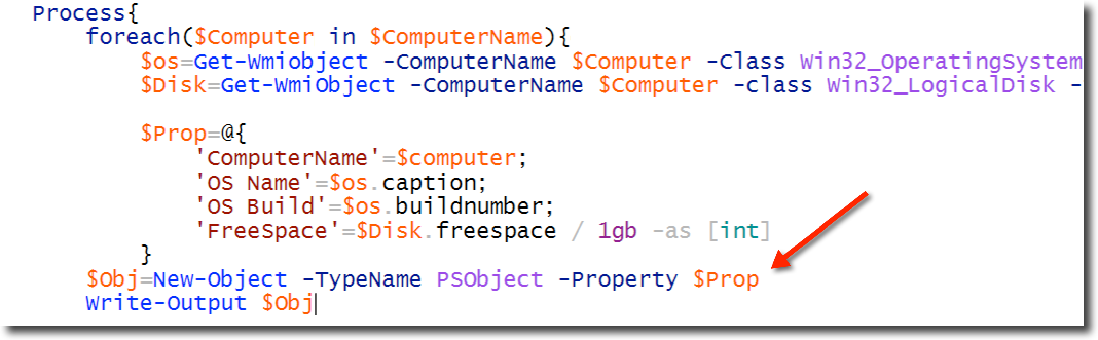
Writing objects out to the pipeline
New-Object

Slide 8
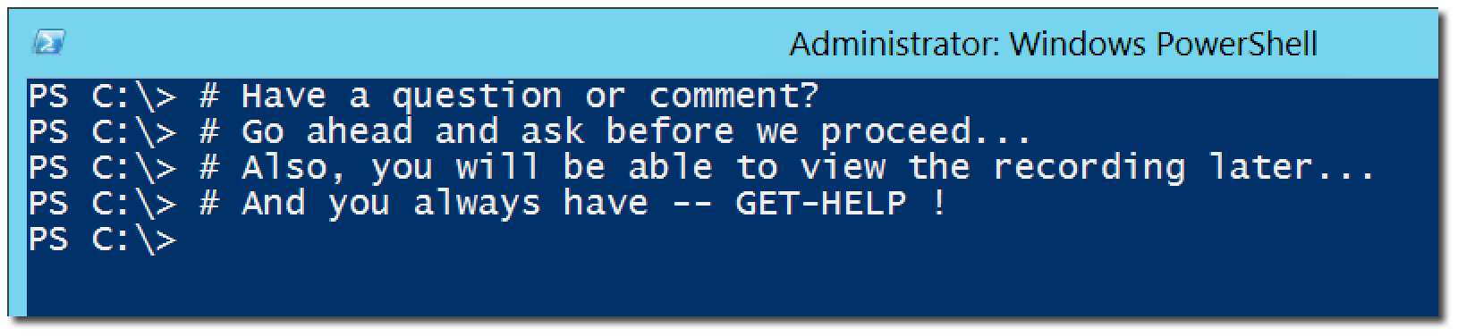
Questions or comments?

